Slide 1

FFT libraries on Fugaku performance experiments using FFTW and SSL2/FFT
2022/11/9 Kazunori Mikami
Operations and Computer Technologies Division
RIKEN Center for Computational Science

Slide 2
outline
Conduct the performance study of FFT on Fugaku using FFTW and SSL2 FFT
Serial performance for 1D, 3D and 3Din1D space patterns
Multi thread performance
Distributed performance
Data type
Mostly focused on the double precision complex subroutines that can handle mixed radix combinations
Example source code, shell scripts
Objective
Hopefully provide some idea to help choosing an appropriate routine for a specific needs

Slide 3
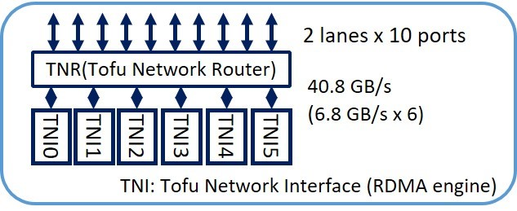
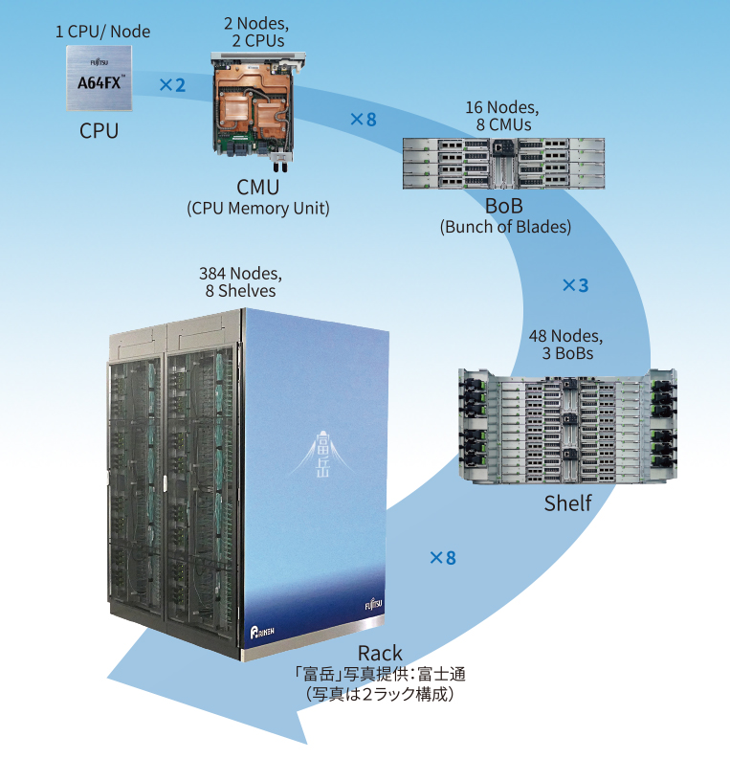
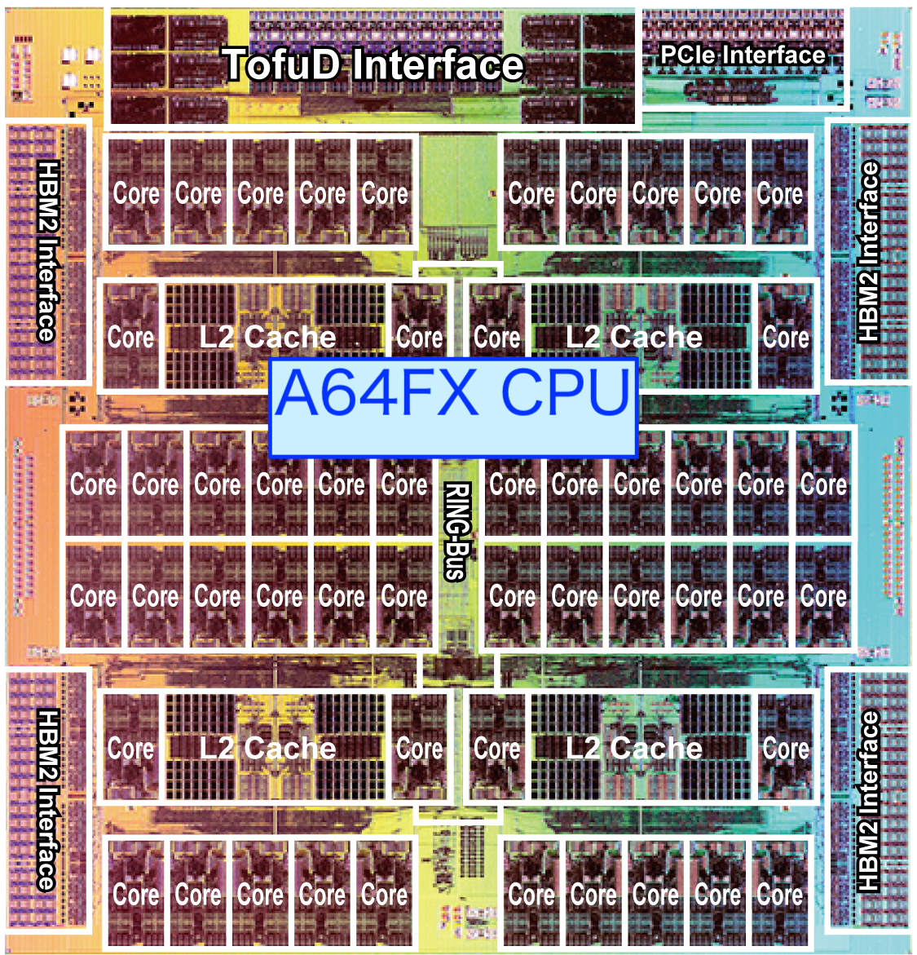
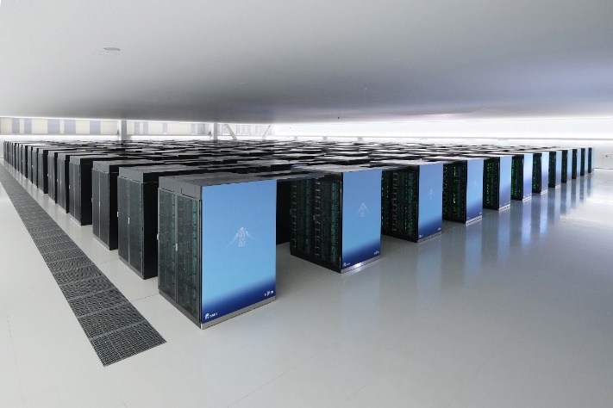
Fugaku hardware at a glance
A64FX CPU
2.0 GHz@base, 64GFlops/core@peak in d.p., 12 cores/CMG.
4 CMGs per CPU with assistant cores : 3TFlops/CPU@peak in d.p., 1CPU/node
L2$ : 8MB/CMG, 1TB/sec/CMG@peak in L2$.
Memory: HBM2 32 GB/CPU (8GB/CMG), 1TB/sec/CPU@peak.
TofuD interconnect
6.8GB/sec injection BW x 6 TNIs per node

Slide 4
Fugaku software environment for using FFT library
Should be used from supported programming environment (lang/tcsds module)
Supported FFT libraries
FFTW
Popular open source FFT library package.
Written in C. Can be called from Fortran/C++/C.
Accepts any data size
FFTW on Fugaku is the enhanced 3.3.10 version with SVE optimization for A64FX.
Made available as a spack package on Fugaku
Building FFTW from the source is also easy. https://github.com/fujitsu/fftw3
SSL/SSL II
Fujitsu’s mathematical libraries
There are many FFT routines in SSLII. Most of them have some restriction in the size, such as radix 2 only or factorizable into 2,3,5,7. Choosing an appropriate routine for specific input data may be bothering.
other FFT libraries known to be working on Fugaku
FFTE, FFTPACK, and perhaps many more…

Slide 5
FFT in serial and parallel context
FFT libraries support serial/thread/distributed FFTs
Serial use
Single process application using single thread ^{(*1)}
MPI parallel application with each process calling serial FFT ^{(*2)}
Thread use
Serial FFT (*1 and/or *2) is computed using thread parallelism
Distributed use
Each MPI processes keep some portion of the total data
Programming effort
Serial and thread FFT routines have simple argument interface
Distributed FFT routines may require data layout study coupled with the application
Performance consideration
architecture fitness, parallel model in FFT, the data size and shape

Slide 6
FFTW – some notes
FFTW executes FFT in two phases – plan and transformation
an appropriate plan is required for each of forward and backward transformation
fftw_execute() for all type of transformation
The total execution time is the sum of plan and transformation
Choosing an appropriate plan often requires tedious try and error effort
Depends on data type (type:complex/real/both, space:1D/2D/3D/nD/multiple1D)
Depends on the plan option
Choice of plan:
FFTW_ESTIMATE, FFTW_MEASURE, FFTW_PATIENT, FFTW_EXHAUSTIVE
fast initialization, slow transform < ------> slower initialization, faster transformation
Consideration in using FFTW : Does the FFT size stay constant, or does it change?
For an application that calls a plan only once and repeats the same size FFTs:
=> FFTW_PATIENT or FFTW_EXHAUSTIVE can be a good choice
For an application that calls plans many times (for different FFT size):
=> FFTW_ESTIMATE or FFTW_MEASURE can be a good choice

Slide 7
SSLII FFT– some notes
SSL routines handle both of setup(a.k.a. plan) and transformation in one call
No separate call is required for setup. Instead, provide an argument to do setup or not.
Choose an appropriate routine for the transformation
Choosing an appropriate routine can be bothering
Must choose a routine depending on
data type (complex/real/both)
space type (1D/2D/3D/multiple1D)
radix restriction
parallel type (serial/threaded/distributed)
Some routines require complex data arrays, others require separate real and imaginary data arrays…

Slide 8
Sample C code calling FFTW - serial
//
// FFTW3 1D complex FFT sample program in C
//
#include <complex.h>
#include <fftw3.h>
int main(int argc, char **argv)
{
const ptrdiff_t nx_dim=8;
fftw_plan plan, pinv;
fftw_complex *indata, *outdata;
int i;
indata = fftw_alloc_complex(nx_dim);
outdata = fftw_alloc_complex(nx_dim);
// set the input data
for (i=0; i<nx_dim; ++i) { indata[i] = i - i*I; }
// create plans for out of place FFT
plan = fftw_plan_dft_1d(nx_dim, indata, outdata, FFTW_FORWARD, FFTW_ESTIMATE);
pinv = fftw_plan_dft_1d(nx_dim, outdata, indata, FFTW_BACKWARD, FFTW_ESTIMATE);
// forward transformation
fftw_execute(plan);
printf("After the FWD trans.\n");
for (i=0; i<nx_dim; ++i) { printf("%20.15f, %20.15f \n", creal(outdata[i]), cimag(outdata[i])); }
// backward synthesis
fftw_execute(pinv);
// normalization
for (i=0; i<nx_dim; ++i) { indata[i] /= (double)(nx_dim); }
printf("After the BACK trans and normalization.\n");
for (i=0; i<nx_dim; ++i) { printf("%20.15f, %20.15f \n", creal(indata[i]), cimag(indata[i])); }
fftw_destroy_plan(plan);
fftw_destroy_plan(pinv);
}

Slide 9
Sample C++ code calling FFTW - serial
//
// FFTW3 1D complex FFT sample program in C++
//
#include <complex>
#include <fftw3.h>
using namespace std;
int main(int argc, char **argv)
{
const int nx_dim=8;
fftw_plan plan, pinv;
complex<double> *indata, *outdata;
int i;
indata = (complex<double> *)fftw_alloc_complex(nx_dim);
outdata = (complex<double> *)fftw_alloc_complex(nx_dim);
// set the input data
for (i=0; i<nx_dim; ++i) { indata[i] = complex<double>(i, -i); }
// create plans for out of place FFT
plan = fftw_plan_dft_1d(nx_dim, reinterpret_cast<fftw_complex*>(indata), reinterpret_cast<fftw_complex*>(outdata), FFTW_FORWARD, FFTW_ESTIMATE);
pinv = fftw_plan_dft_1d(nx_dim, reinterpret_cast<fftw_complex*>(outdata), reinterpret_cast<fftw_complex*>(indata), FFTW_BACKWARD, FFTW_ESTIMATE);
// forward transformation
fftw_execute(plan);
printf("After the FWD transformation.\n");
for (i=0; i<nx_dim; ++i) { printf("%20.15f, %20.15f \n", real(outdata[i]), imag(outdata[i])); }
// backward synthesis
fftw_execute(pinv);
// normalization
for (i=0; i<nx_dim; ++i) { indata[i] /= (double)(nx_dim); }
printf("After the BACK and normalization.\n");
for (i=0; i<nx_dim; ++i) { printf("%20.15f, %20.15f \n", real(indata[i]), imag(indata[i])); }
fftw_destroy_plan(plan);
fftw_destroy_plan(pinv);
}

Slide 10
Sample Fortran code calling FFTW - serial
!cx FFTW3 1D complex FFT sample program in Fortran
program serial_1D__fftw3
#include "fftw3.f"
integer, parameter :: ndata=2**3
integer*8 plan, pinv
complex(kind=8), allocatable :: in(:), out(:)
allocate(in(ndata),out(ndata),stat=iaq2)
if ((iaq2).ne.0) then ; stop "allocate failed"; endif
!cx Set the input array
do i = 1,ndata; in(i) = dcmplx(real(i), -real(i)) ; enddo
!cx create plans for out of place FFT
call dfftw_plan_dft_1d ( plan, ndata, in, out, FFTW_FORWARD, env_integer)
call dfftw_plan_dft_1d ( pinv, ndata, out, in, FFTW_BACKWARD, env_integer)
!cx forward transformation
call dfftw_execute ( plan)
write(*,*) 'after the forward transformation'
do i = 1,ndata
write(*,'(a,i3,a,2f10.3)') ' out(',i,') = ',out(i)
enddo
!cx backward synthesis
call dfftw_execute ( pinv)
!cx normalization
do i = 1,ndata; in(i)=in(i)/real(ndata); enddo
write(*,*) 'after the backward synthesis and normalization'
do i = 1,ndata
write(*,'(a,i3,a,2f10.3)') ' in(',i,') = ', in(i)
enddo
call dfftw_destroy_plan ( plan)
call dfftw_destroy_plan ( pinv)
deallocate(in)
deallocate(out)
stop
end
Note that these are
legacy interface

Slide 11
Sample Fortran code calling FFTW – multi thread
!cx the difference in blue
program serial_1D__fftw3
use omp_lib
#include "fftw3.f"
integer, parameter :: ndata=2**3
integer*8 plan, pinv
complex(kind=8), allocatable :: in(:), out(:)
allocate(in(ndata),out(ndata),stat=iaq2)
if ((iaq2).ne.0) then ; stop "allocate failed"; endif
call dfftw_init_threads(iret)
nthreads=omp_get_max_threads()
call dfftw_plan_with_nthreads(nthreads)
!cx Set the input array
do i = 1,ndata; in(i) = dcmplx(real(i), -real(i)) ; enddo
!cx create plans for out of place FFT
call dfftw_plan_dft_1d ( plan, ndata, in, out, FFTW_FORWARD, env_integer)
call dfftw_plan_dft_1d ( pinv, ndata, out, in, FFTW_BACKWARD, env_integer)
!cx forward transformation
call dfftw_execute ( plan)
!cx backward synthesis
call dfftw_execute ( pinv)
!cx normalization
do i = 1,ndata; in(i)=in(i)/real(ndata); enddo
call dfftw_destroy_plan ( plan)
call dfftw_destroy_plan ( pinv)
deallocate(in)
deallocate(out)
stop
end

Slide 12
Sample C code calling FFTW – distributed 3D FFT case
// the difference in blue
#include <complex.h>
#include <fftw3-mpi.h>
#include <mpi.h>
int main(int argc, char **argv)
{
const ptrdiff_t nx_dim=8;
fftw_plan plan, pinv;
fftw_complex *cdata, *cftdata;
int I, npes, my_id;
ptrdiff_t alloc_local, my_dim, my_dim_start;
MPI_Init(&argc, &argv);
MPI_Comm_rank(MPI_COMM_WORLD, &my_id);
MPI_Comm_size(MPI_COMM_WORLD, &npes);
fftw_mpi_init();
// set local size
alloc_local = fftw_mpi_local_size_3d(nx_dim, ny_dim, nz_dim, MPI_COMM_WORLD, &my_dim, &my_dim_start);
cdata = fftw_alloc_complex(alloc_local);
cftdata = fftw_alloc_complex(alloc_local);
// create plans for out of place FFT
plan = fftw_mpi_plan_dft_3d(nx_dim, ny_dim, nz_dim, cdata, cftdata, MPI_COMM_WORLD, FFTW_FORWARD, MY_PLAN);
pinv = fftw_mpi_plan_dft_3d(nx_dim, ny_dim, nz_dim, cftdata, cdata, MPI_COMM_WORLD, FFTW_BACKWARD, MY_PLAN);
// set the input data
for (i=0; i<nx_dim; ++i) { cdata[i] = i - i*I; }
// forward transformation
fftw_execute(plan);
// backward synthesis
fftw_execute(pinv);
// normalization
for (i=0; i<nx_dim; ++i) { cdata[i] /= (double)(nx_dim*ny_dim*nz_dim); }
fftw_destroy_plan(plan);
fftw_destroy_plan(pinv);
}

Slide 13
compile, link and execute using spack FFTW - serial
login$ cat myjob.sh
#PJM directive lines are omitted for saving space
source /vol0004/apps/oss/spack/share/spack/setup-env.sh
# spack find -lv fftw
spack load fujitsu-fftw%fj@4.8.0
FFTW_INCLUDE_PATH=`echo "${C_INCLUDE_PATH}"| cut -f1 -d':'`
FFTW_DIR=`dirname "${FFTW_INCLUDE_PATH}"`
SRC=${HOME}/fftw/src_fftw3
CFLAGS="-Kfast -I${FFTW_DIR}/include ”
CXXFLAGS="-Kfast -I${FFTW_DIR}/include "
FFLAGS="-Kfast -I${FFTW_DIR}/include -Nlst=t "
LDFLAGS="-L${FFTW_DIR}/lib -lfftw3 ” # LDFLAGS+="--linkfortran ” # if linking with C++ driver
# mpi*** linkers are used below because FFTW wants libmpi.*
cp $SRC/main_fftw3_complex_1d.serial.F main.F90; mpifrt -o fftw.ex $FFLAGS main.F90 $LDFLAGS # if Fortran
cp $SRC/fftw3_complex_1D.serial.c main.c ; mpifcc -o fftw.ex $CFLAGS main.c $LDFLAGS # if C
cp $SRC/fftw3_complex_1D.serial.cpp main.cpp ; mpiFCC -o fftw.ex $CXXFLAGS main.cpp $LDFLAGS # if C++
./fftw.ex
login$ pjsub myjob.sh

Slide 14
compile, link and execute using your own FFTW - serial
login$ cat myjob.sh
#PJM directive lines are omitted for saving space
FFTW_DIR=${HOME}/fftw/my_version/local
SRC=${HOME}/fftw/src_fftw3
CFLAGS="-Kfast -I${FFTW_DIR}/include ”
CXXFLAGS="-Kfast -I${FFTW_DIR}/include "
FFLAGS="-Kfast -I${FFTW_DIR}/include -Nlst=t "
LDFLAGS="-L${FFTW_DIR}/lib -lfftw3 ” # LDFLAGS+="--linkfortran ” # if linking with C++ driver
# mpi*** linkers are used below because FFTW wants libmpi.*
cp $SRC/main_fftw3_complex_1d.serial.F main.F90; mpifrt -o fftw.ex $FFLAGS main.F90 $LDFLAGS # if Fortran
cp $SRC/fftw3_complex_1D.serial.c main.c ; mpifcc -o fftw.ex $CFLAGS main.c $LDFLAGS # if C
cp $SRC/fftw3_complex_1D.serial.cpp main.cpp ; mpiFCC -o fftw.ex $CXXFLAGS main.cpp $LDFLAGS # if C++
./fftw.ex
login$ pjsub myjob.sh

Slide 15
compile, link and execute using your own FFTW – multi thread and MPI distributed
Add options for multi thread context
# if calling multi thread APIs
LDFLAGS+=”-Kopenmp -L${FFTW_DIR}/lib -lfftw3_omp ”
export LD_LIBRARY_PATH=${FFTW_DIR}/lib:${LD_LIBRARY_PATH}
Add options for MPI context
# if calling MPI APIs
LDFLAGS+="-L${FFTW_DIR}/lib -lfftw3_mpi -lfftw3 "
export LD_LIBRARY_PATH=${FFTW_DIR}/lib:${LD_LIBRARY_PATH}

Slide 16
compile, link and execute using SSL
Options to link corresponding SSL FFT routines in fortran case
Serial context
LDFLAGS+=”-SSL2 –linkstl=libfjc++ ”
Multi thread context
LDFLAGS+=”-SSL2BLAMP --linkstl=libfjc++ -Kopenmp”
MPI context
LDFLAGS+=”-SSL2MPI --linkstl=libfjc++ ”

Slide 17
Performance stats – serial 1D benchmark
double precision complex-complex 1D serial FFT
Computed using a single serial-thead process
The actual source programs are shown in the attachment.
Only one core on a CPU is used
Assumption in counting the number of F.P. operations per FFT size N
Nfp = 5Nlog₂N
Routines that can handle various radix numbers are tested
FFTW: fftw_execute()
SSLII: vmcf1() <= corrected!

Slide 18
performing serial FFT

Slide 19
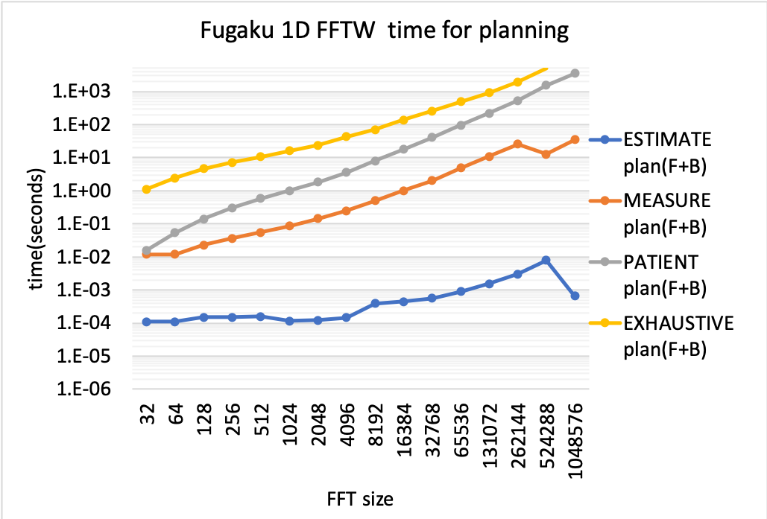
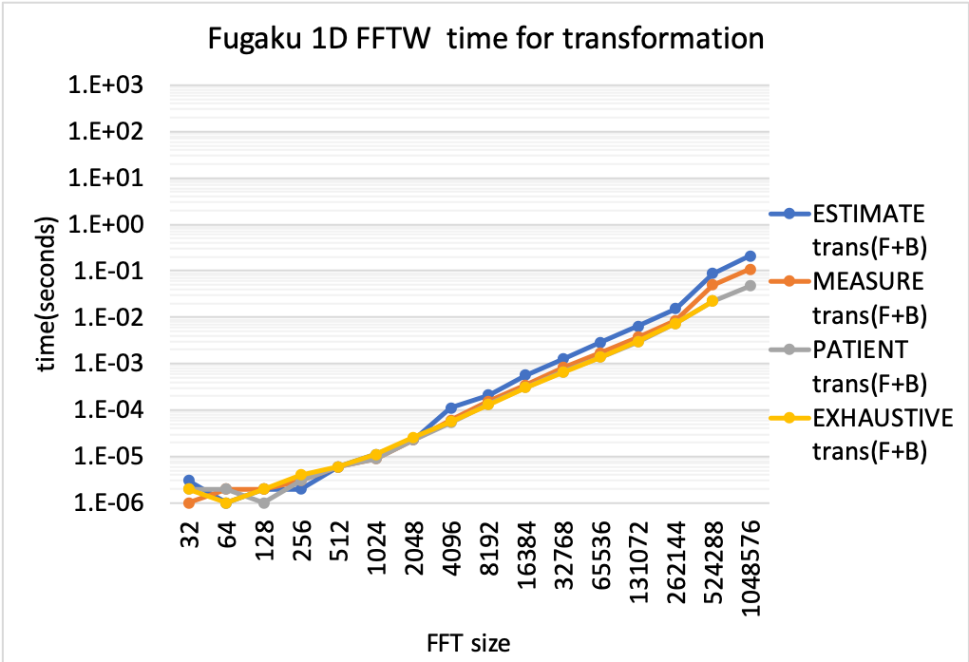
FFTW on Fugaku – simple 1D benchmark
double precision complex 1D serial FFT – plan and transformation time
The planning (setup) time varies a lot depending on the plan
FFTW_ESTIMATE <FFTW_MEASURE <FFTW_PATIENT <FFTW_EXHAUSTIVE
The transformation time is somewhat affected by the choice of plan

Slide 20
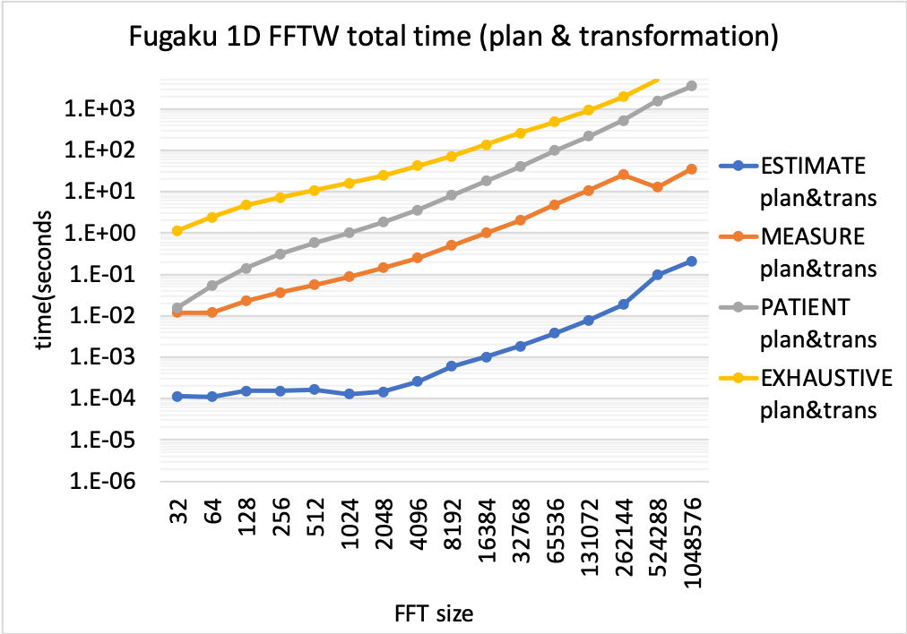
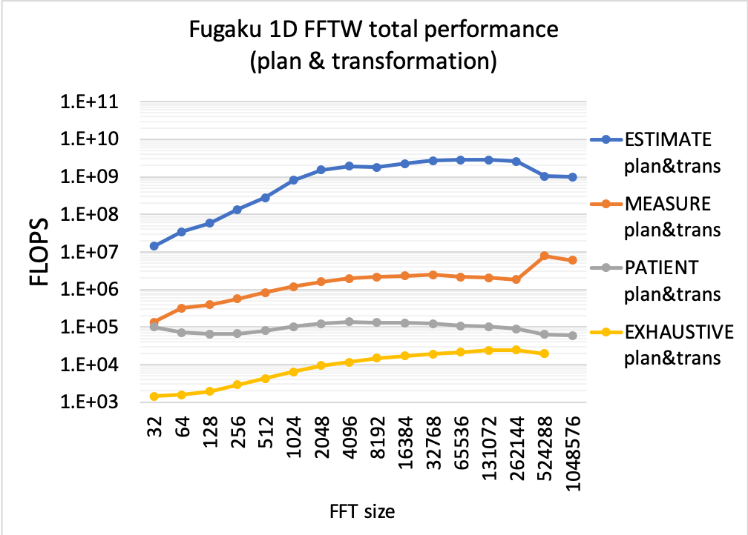
FFTW on Fugaku – simple 1D benchmark
D.P. complex 1D serial FFT – the total time and the total performance
the total time is dominated by the planning time except for ESTIMATE

Slide 21
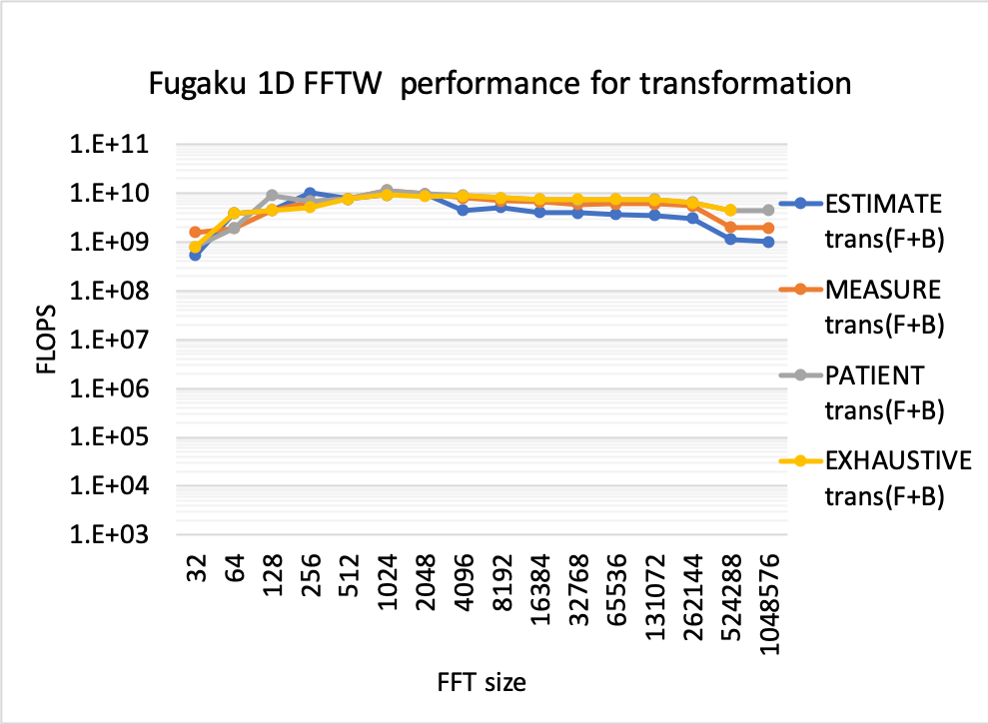
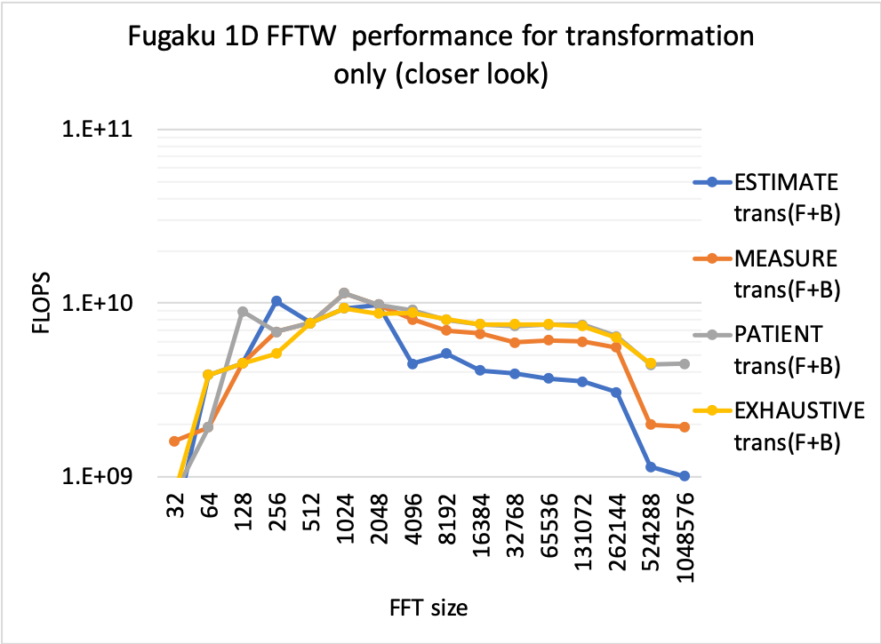
FFTW on Fugaku – simple 1D benchmark
D.P. complex 1D serial FFT – the performance for the transformation phase (F+B)

Slide 22
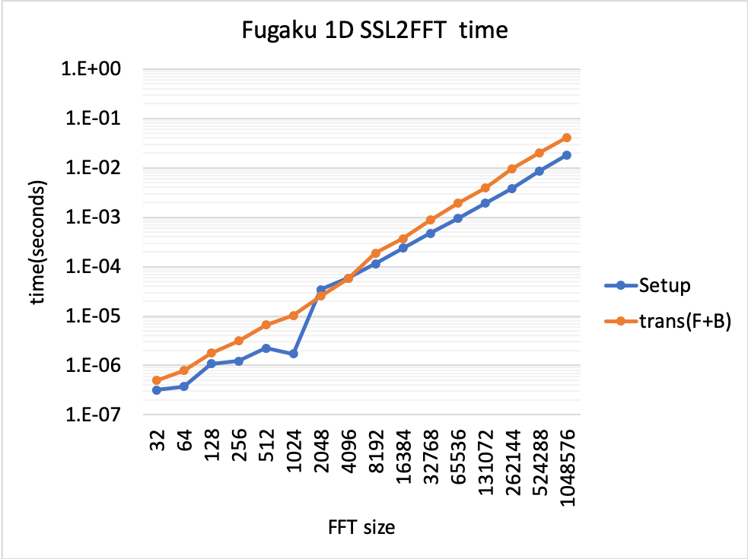
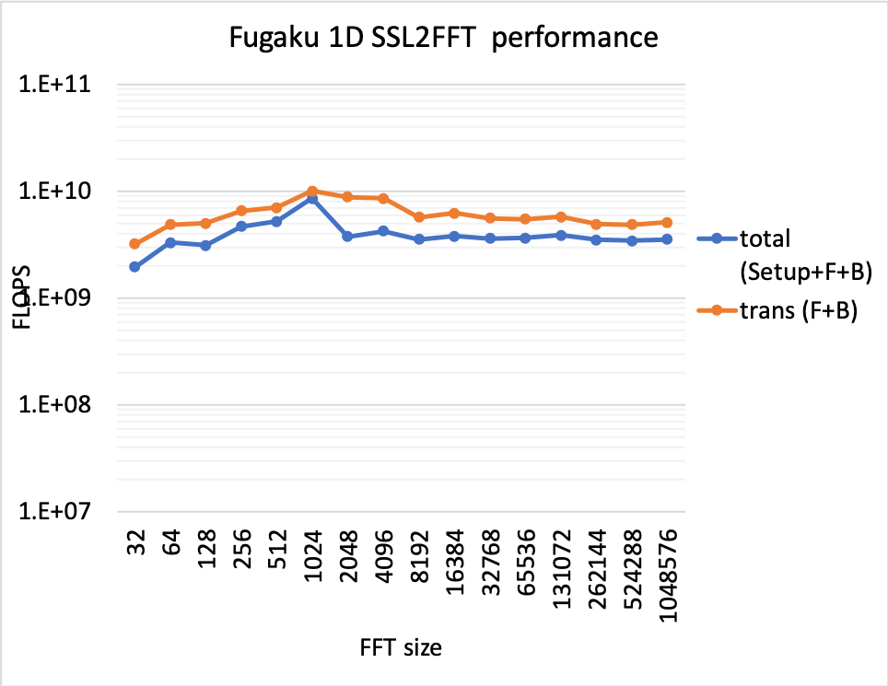
SSL2-FFT on Fugaku – simple 1D benchmark
D.P. complex 1D serial FFT – time and performance
only one core on a CPU is used, single fwd+back transformation including setup
Tested routine : dvmcf1()
Time to setup is less than the transformation time

Slide 23
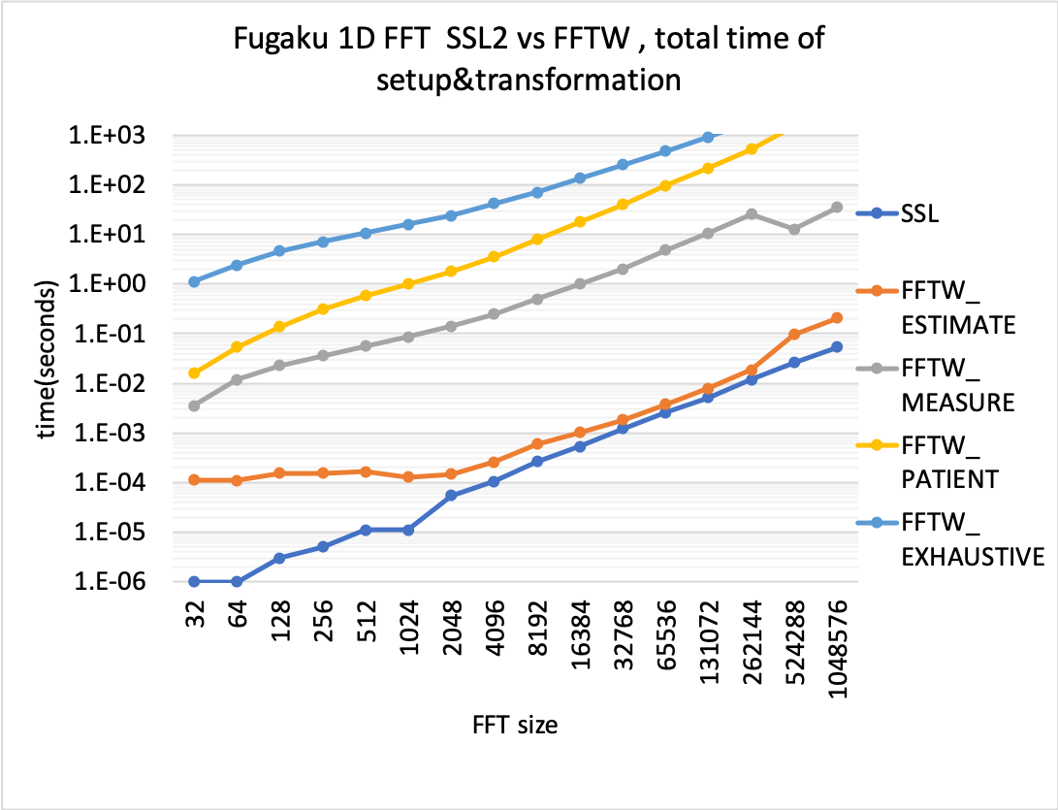
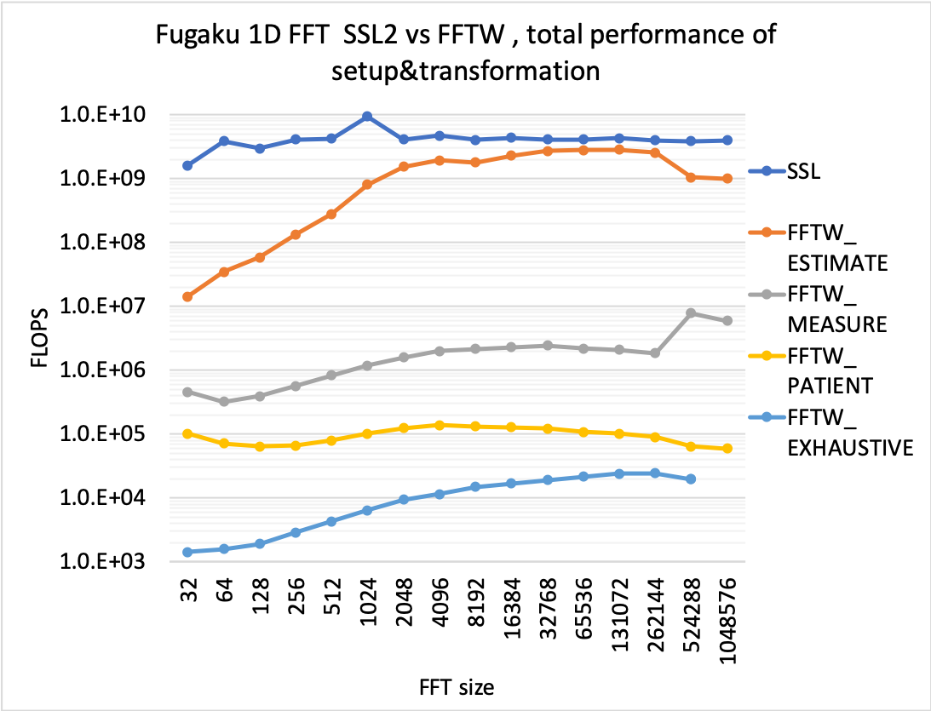
SSL2-FFT vs FFTW on Fugaku – simple 1D benchmark
D.P. complex 1D serial FFT - comparing the libraries
Looking at the total time (sum of the initialization and the transformation)
SSL2-FFT is faster than others for this scenario

Slide 24
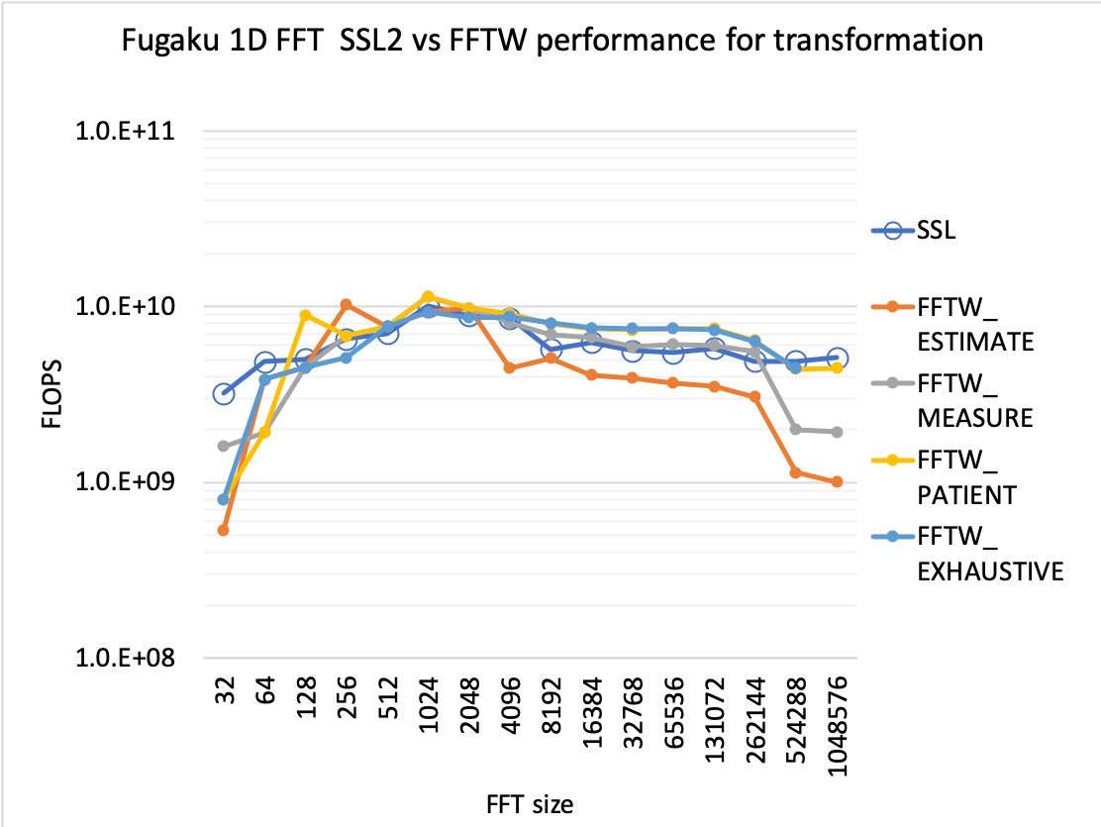
SSL2-FFT vs FFTW on Fugaku – simple 1D benchmark
D.P. complex 1D serial FFT
Looking at the performance of the transformation (F+B) phase only

Slide 25
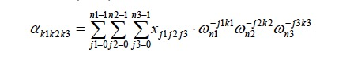
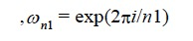
3D benchmark
D.P. complex 3D serial FFT in all 3 axes
each axis may include mixed radix combinations
only one core on a CPU is used, single fwd+back transformation including setup(plan)
benchmark size is limited to
NX = NY = NZ = 32
NX = NY = NZ = 64
NX = NY = NZ = 128
NX = NY = NZ = 256
NX = NY = NZ = 512
NX = NY = 1024 , NZ = 512
Y dim.
Z dim.
counting the number of F.P. operations the same way as 1D
per FFT size Nxyz (Nx * Ny * Nz), Nfp = 5 Nxyz log₂Nxyz
X dim.

Slide 26
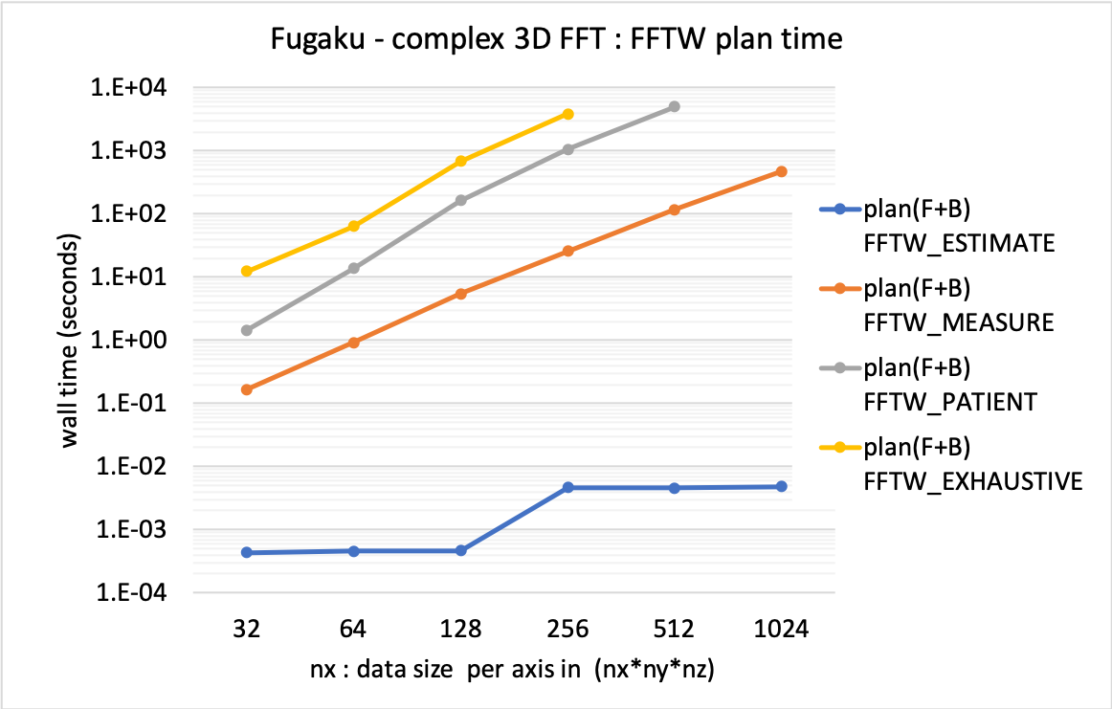
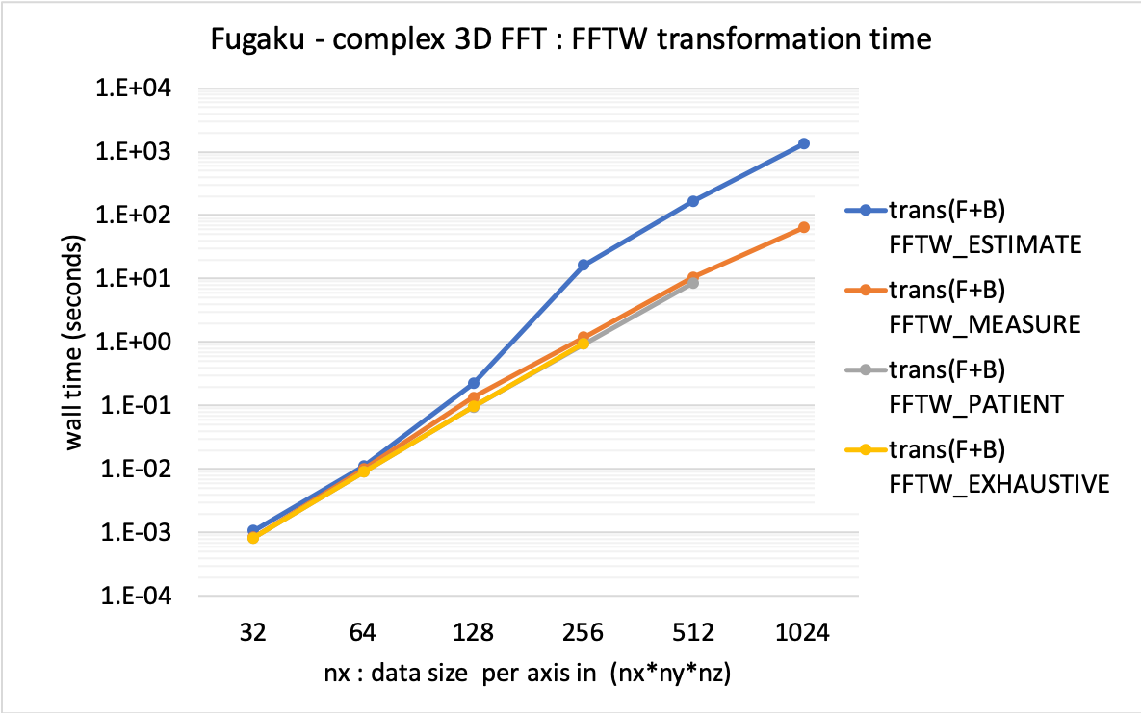
FFTW on Fugaku –3D benchmark
D.P. complex 3D serial FFT– plan time and transformation time
Tested routine : dfftw_plan_many_dft() and dfftw_execute_dft()
plan time varies a lot, like 1D
Transformation time varies for data larger than 128³ grids
FFT using FFTW_ESTIMATE plan takes 10x slower than other plans

Slide 27
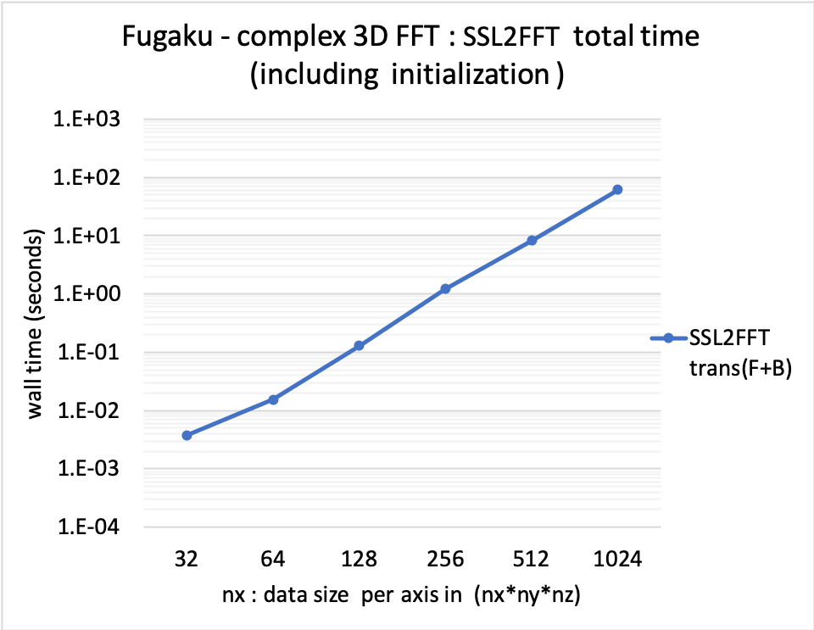
SSL2 FFT on Fugaku –3D benchmark
D.P. complex 3D serial FFT– SSL2 total time
Tested routine : dvmcf2()
Looking at the total time of single round trip call. Setup time turned out negligible

Slide 28
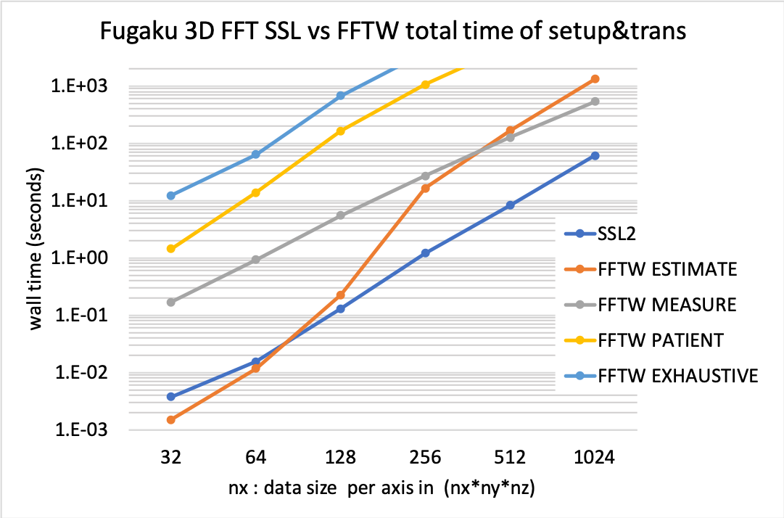
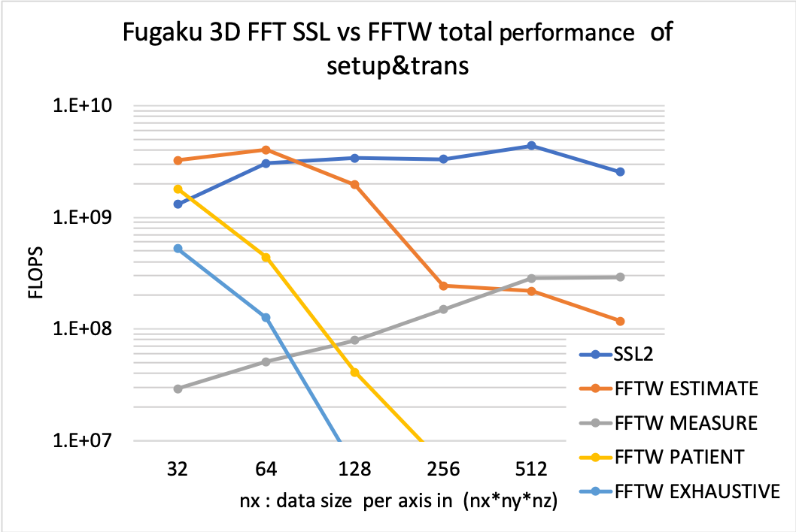
SSL2-FFT vs FFTW on Fugaku – 3D benchmark
D.P. complex 3D serial FFT - comparing the libraries
Looking at the total time of single round trip call
FFTW : sum of plan(F+B) and trans(F+B)
SSL2 : sum of FWD (setup and trans) and BACK (trans)

Slide 29
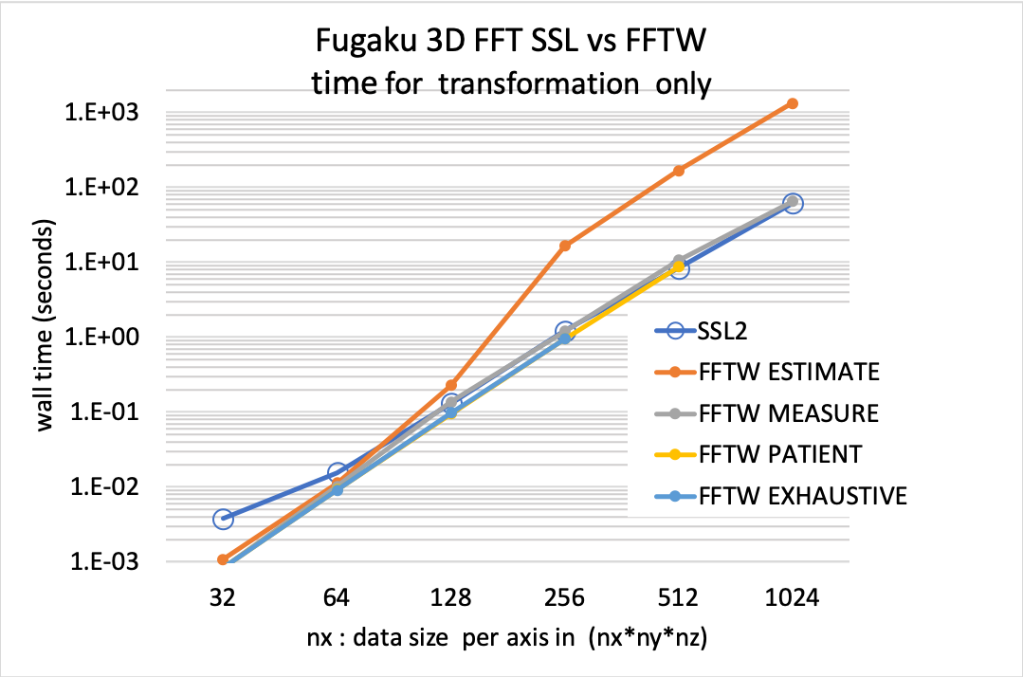
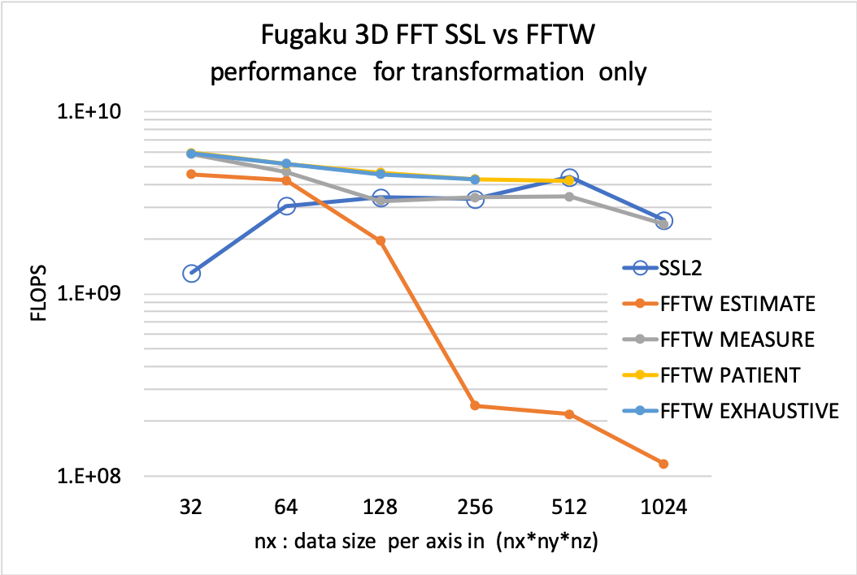
SSL2-FFT vs FFTW on Fugaku – 3D benchmark
D.P. complex 3D serial FFT - comparing the libraries
Looking at the time for transformation (FWD+BACK) only
SSL2 and FFTW_MEASURE performance is close

Slide 30
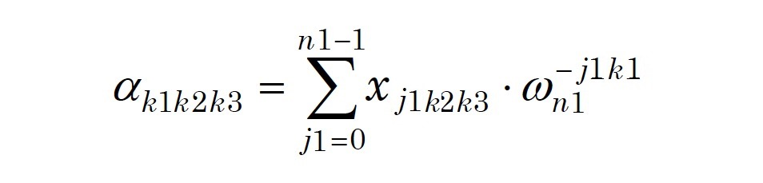
3D space FFT in 1D vectors - a real application case
in double precision 3D space, conduct many 1D transforms
FFT type:
X dim: complex to complex
Y dim: complex to complex
Z dim(1) : complex to complex
Z dim(2) : real to complex FWD + complex to real BACK
benchmark size is set to NX=NY=NZ = 2^p, p=5,6,..,10
32, 64, 128, 256, 512, 1024 ^{(note)} NZ=NX/2 for 1024
Application FFT size of interest
reference FFT size in a quantum chemistry code/data
(nx,ny,nz)= (42, 64, 42) per process
FFT along X dimension
FFT size=NX
Number of FFTs = NY*NZ
FFT along Y dimension
FFT size=NY
Number of FFTs = NX*NZ
Y dim.
FFT along Z dimension
FFT size=NZ
Number of FFTs = NX*NY
Z dim.
Number of F.P. ops in multi FFTs along X dim.:
5 * Nx * log2(Nx) * Ny * Nz
ditto for Y and Z dim
X dim.

Slide 31
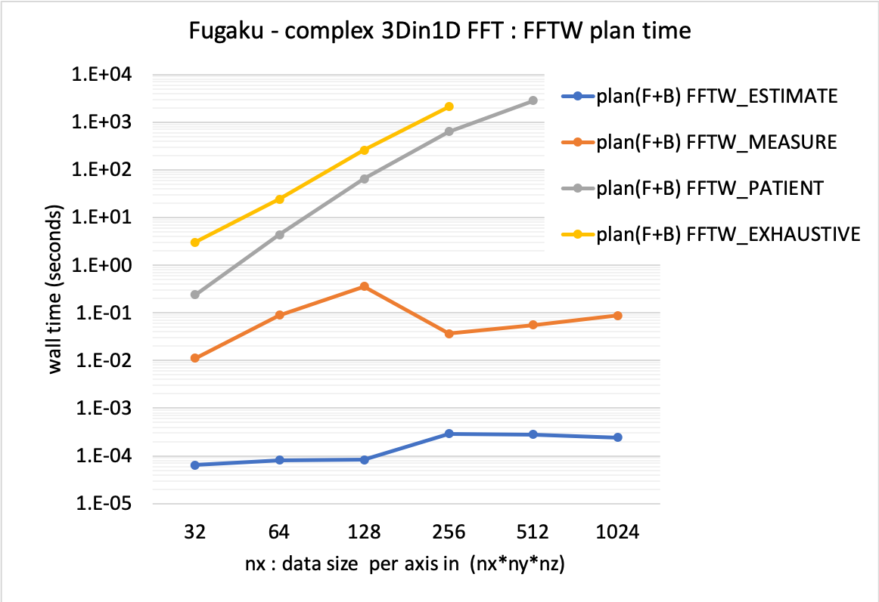
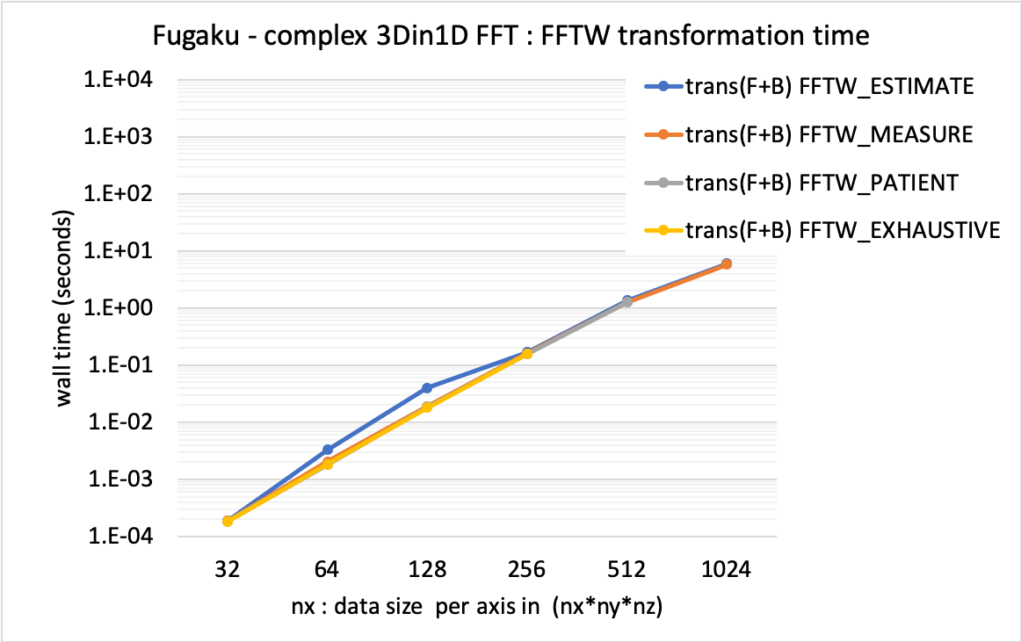
FFTW on Fugaku – 3Din1D vectors
D.P. complex 3Din1D vectors – FFTW multiple 1D FFTs along X axis
tested routine: dfftw_plan_many_dft() + dfftw_execute_dft()
plan time changes in the same tendency as 1D or 3D (1D < 3Din1D < 3D)
Choice of plan does not affect the transformation time in this range

Slide 32
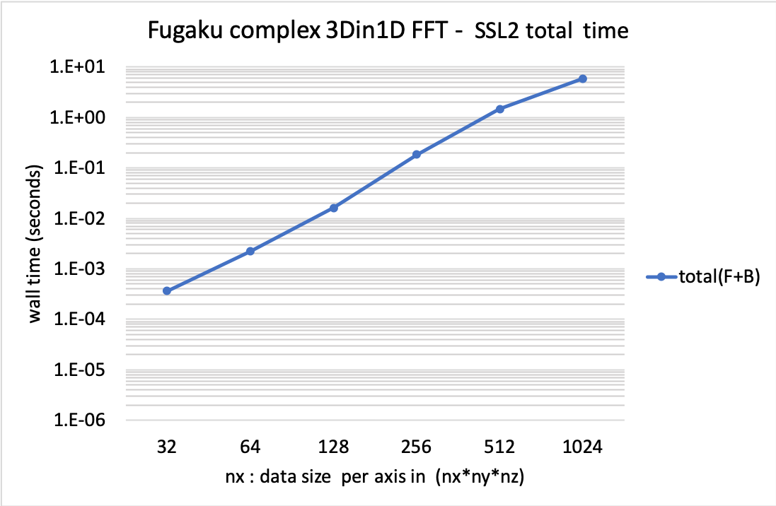
SSL2 on Fugaku – 3D FFT in 1D vectors
D.P. complex 3D FFT in 1D vectors – multiple 1D FFTs along X axis
Tested routine : dvmcf2() - it does not separate setup and transformation
Looking at the total time of single round trip call including setup

Slide 33
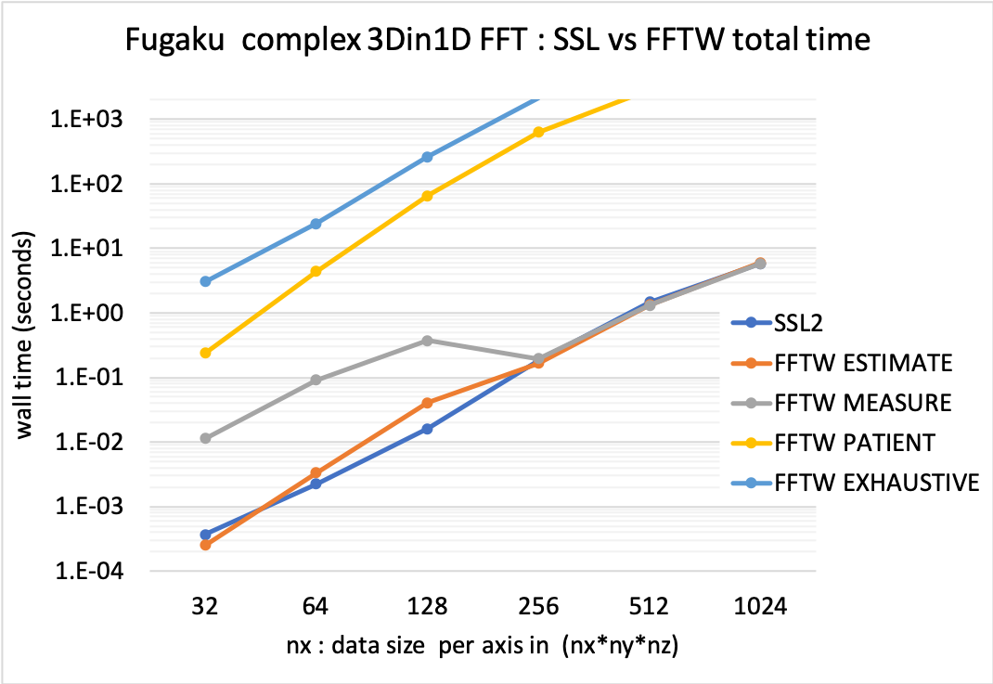
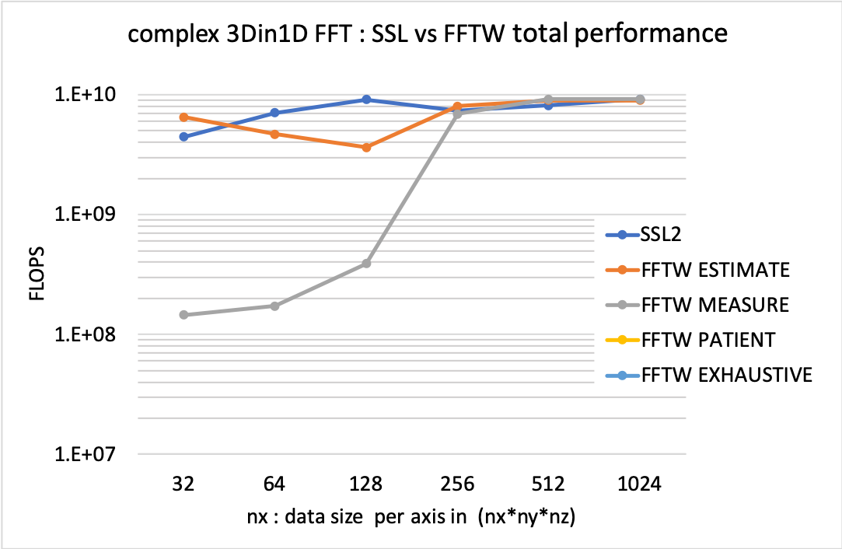
SSL2-FFT vs FFTW on Fugaku – 3D FFT in 1D vectors
multiple 1D FFTs along X axis - comparing the libraries
Looking at the total time of single round trip call including setup
FFTW : sum of plan(F+B) and trans(F+B)
SSL2 : sum of FWD (setup and trans) and BACK (setup and trans)
Zone of interest in this application

Slide 34
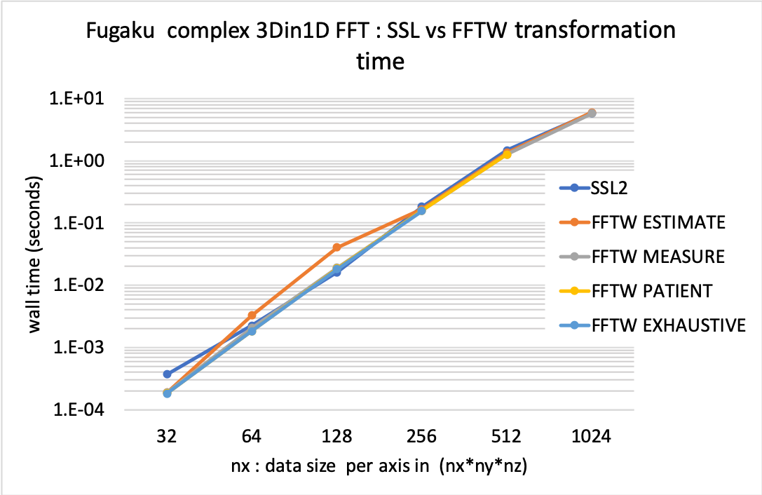
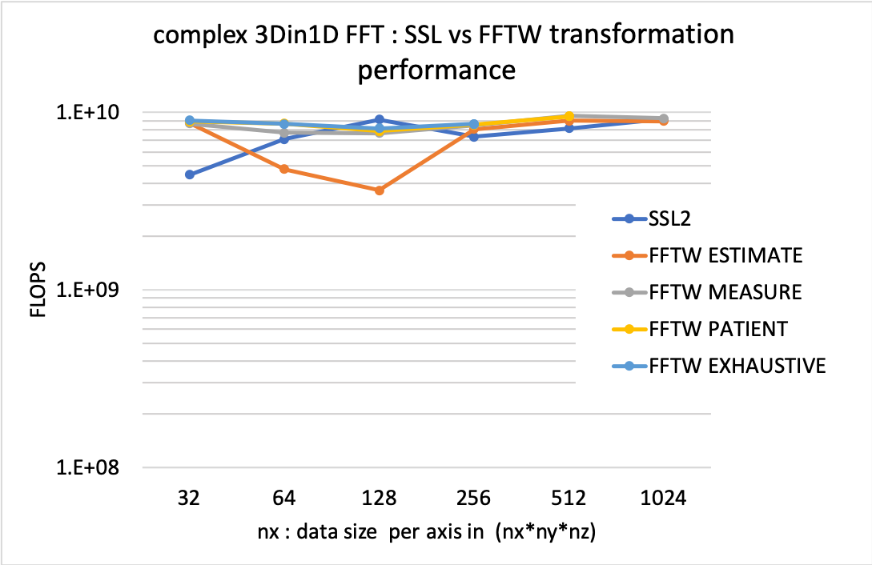
SSL2-FFT vs FFTW on Fugaku – 3D FFT in 1D vectors
multiple 1D FFTs along X axis - comparing the libraries
Looking at the transformation (FWD+BACK) phase only

Slide 35
3Din1D hardware performance for FFTW and SSL2
# PMlib Basic Report from a quantum chemistry code #
Origianl FFTW version
Section | number of| measured time in total, %, per call, SD| hardware vectorized F.P. ops.
Label | calls | time[sec] [%] time/call std.dev. | f.p.ops sdv vectorized%
----------------------+----------+----------------------------------------+--------------------------------
main (*) : 1 7.780e+02 100.00 7.780e+02 7.26e-02 1.477e+12 2.46e+10 0.00 (%)(*)
elmin (*) : 1 6.415e+02 82.46 6.415e+02 3.92e-03 1.298e+12 2.44e+10 0.00 (%)(*)
eddav (*) : 13 6.283e+02 80.76 4.833e+01 2.68e-03 1.286e+12 2.38e+10 0.00 (%)(*)
hamiltmu (*) : 43265 2.363e+02 30.38 5.462e-03 2.28e+00 4.397e+11 4.63e+09 0.00 (%)(*)
fft3d_mpi (*) : 93175 1.637e+02 21.04 1.757e-03 2.65e+00 1.553e+11 8.68e+09 0.00 (%)(*)
fftbas_plan_mpi (*) : 93177 1.594e+02 20.49 1.711e-03 2.62e+00 1.555e+11 8.68e+09 0.00 (%)(*)
dfftw_execute : 279525 6.557e+01 8.43 2.346e-04 4.15e+00 1.523e+11 7.04e+09 36.86 (%) <= 2.3 GFlop
dfftw_plan_many : 93177 3.019e+01 3.88 3.240e-04 4.70e+00 3.181e+09 2.03e+09 92.19 (%) <= 0.7 GFlop
----------------------+----------+----------------------------------------+--------------------------------
SSL2 version
Section | number of| measured time in total, %, per call, SD| hardware vectorized F.P. ops.
Label | calls | time[sec] [%] time/call std.dev. | f.p.ops sdv vectorized%
----------------------+----------+----------------------------------------+--------------------------------
main (*) : 1 7.990e+02 100.00 7.990e+02 5.78e-02 1.578e+12 2.54e+10 0.00 (%)(*)
elmin (*) : 1 6.638e+02 83.08 6.638e+02 4.84e-03 1.398e+12 2.52e+10 0.00 (%)(*)
eddav (*) : 13 6.498e+02 81.33 4.999e+01 4.79e-03 1.380e+12 2.44e+10 0.00 (%)(*)
hamiltmu (*) : 43265 2.469e+02 30.91 5.707e-03 2.51e+00 4.868e+11 5.23e+09 0.00 (%)(*)
fft3d_mpi (*) : 93175 1.872e+02 23.43 2.009e-03 1.91e+00 2.567e+11 1.00e+10 0.00 (%)(*)
fftbas_plan_mpi (*) : 93177 1.828e+02 22.88 1.962e-03 1.90e+00 2.567e+11 1.00e+10 0.00 (%)(*)
SSL2_FFT : 279511 1.249e+02 15.63 4.469e-04 5.51e+00 2.567e+11 1.00e+10 99.96 (%) <= 2.1 GFlop
----------------------+----------+----------------------------------------+--------------------------------

Slide 36
performing multi thread and distributed FFT

Slide 37
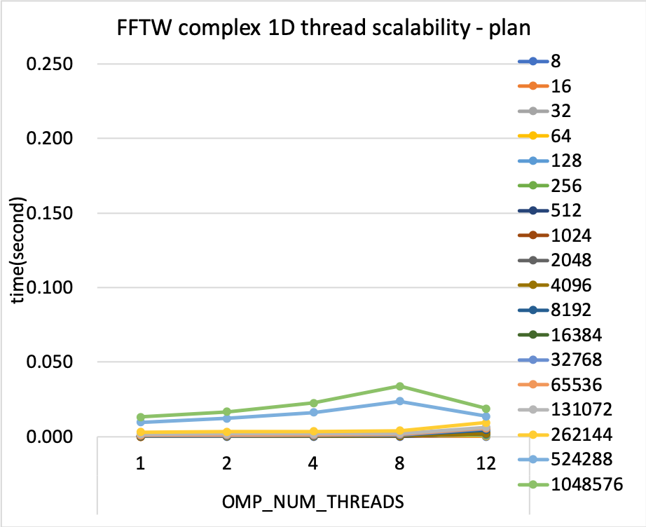
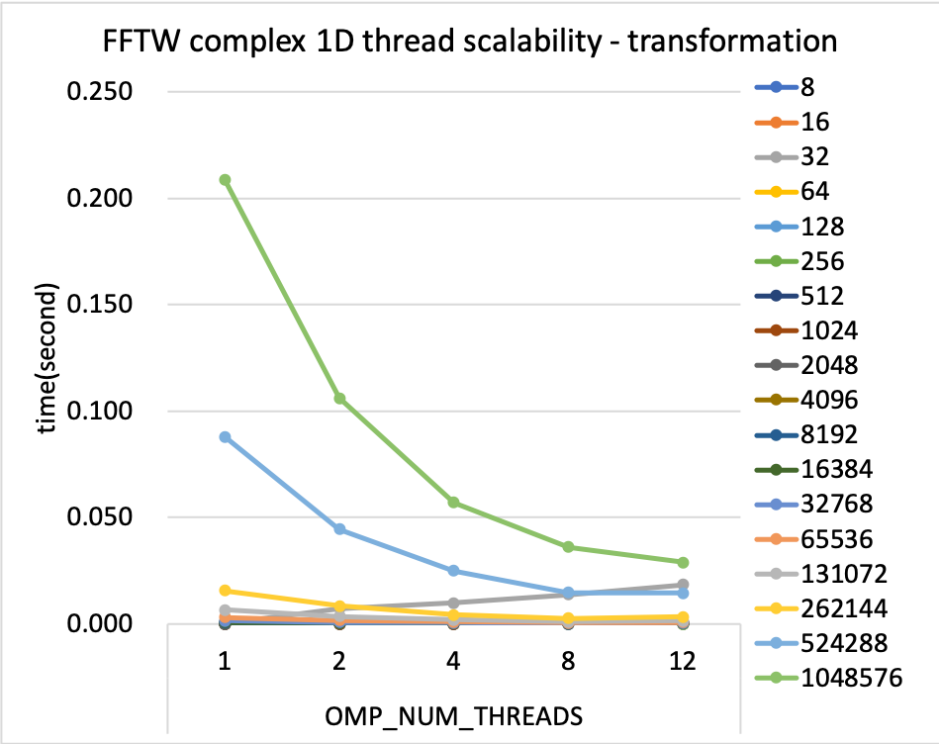
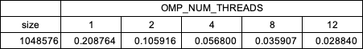
FFTW on Fugaku – 1D multi thread benchmark
double precision complex 1D threaded FFT – thread scalability (F+B)
one process per CMG, 1 ~ 12 threads per CMG
plan : dfftw_plan_dft_1d ( .., FFTW_ESTIMATE)

Slide 38
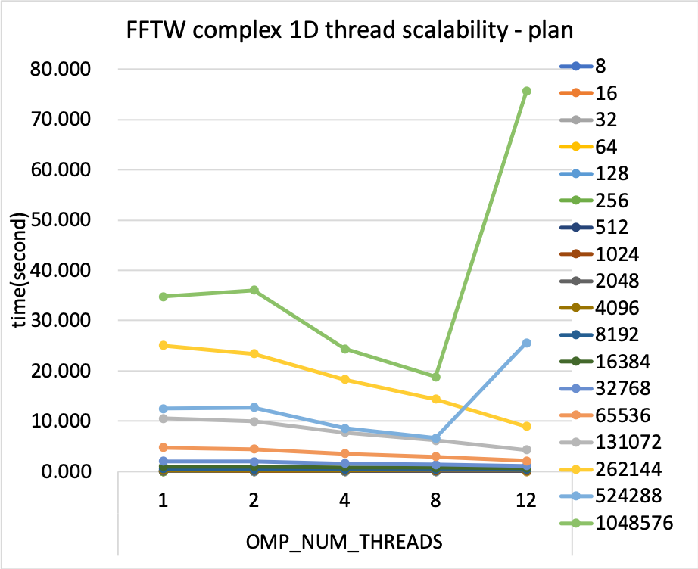
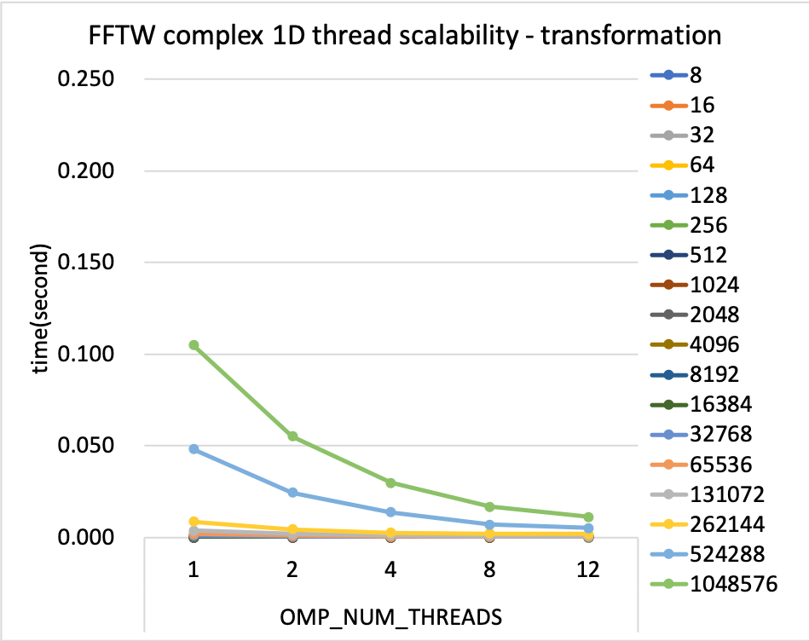
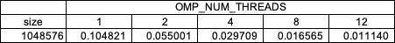
FFTW on Fugaku – 1D multi thread benchmark
double precision complex 1D threaded FFT – thread scalability (F+B)
plan : dfftw_plan_dft_1d ( .., FFTW_MEASURE)

Slide 39
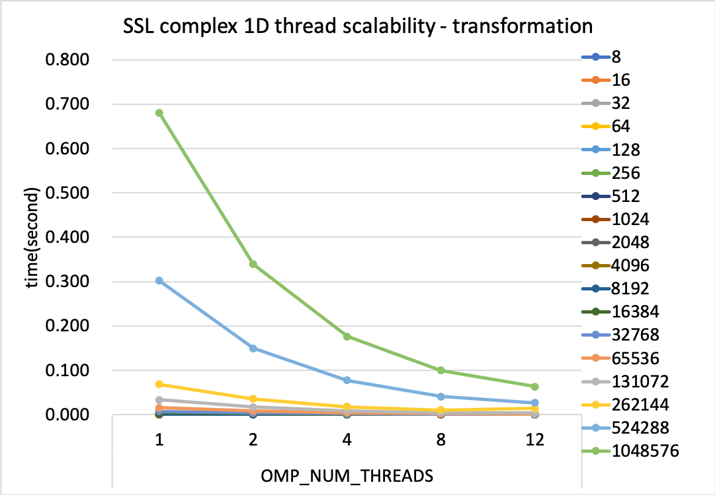
SSLII FFT on Fugaku – 1D multi thread benchmark
double precision complex 3D threaded FFT
one process per CMG, 1 ~ 12 threads per CMG
Tested routine : dm_v1dcft2() : out of place transformation
Restriction in thread routines – radices are limited to 2, 3, 5, 7
the size must be factorized to the products of [2,3,5,7], i.e. size = 2^{n2} * 3^{n3} * 5^{n5} * 7^{n7}
The base performance of this thread routine is not good

Slide 40
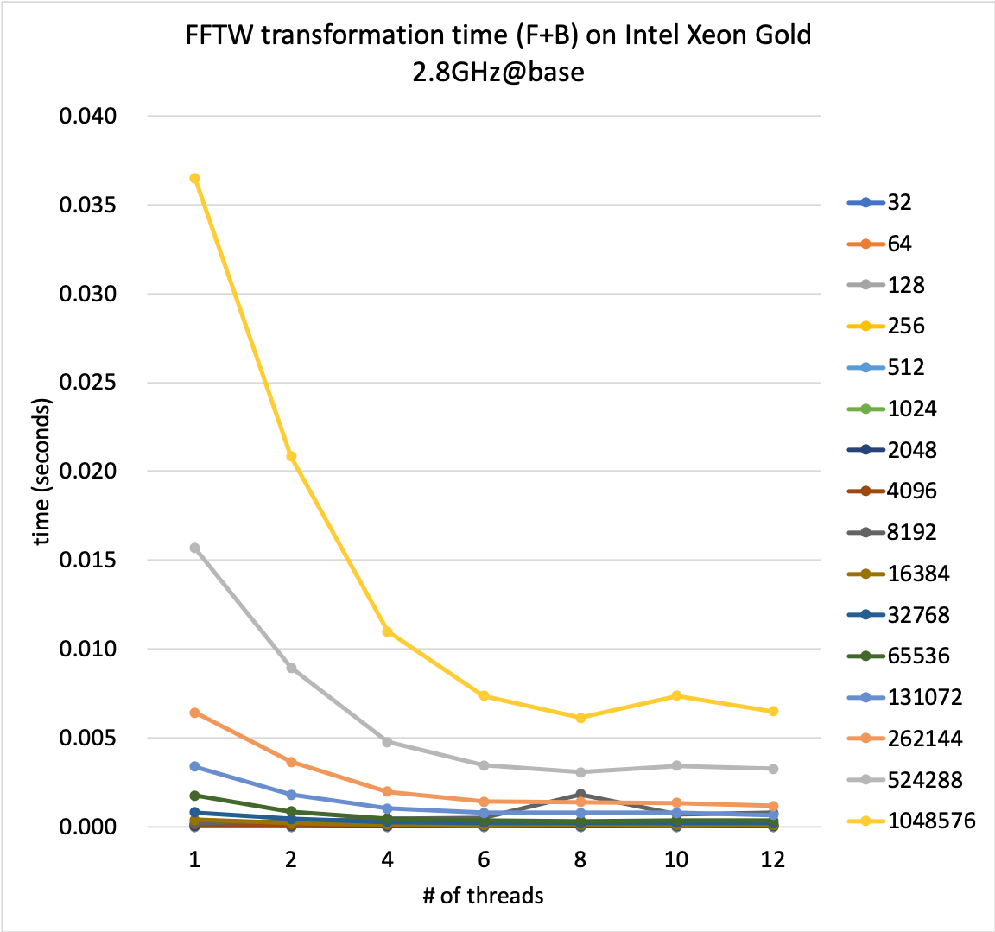
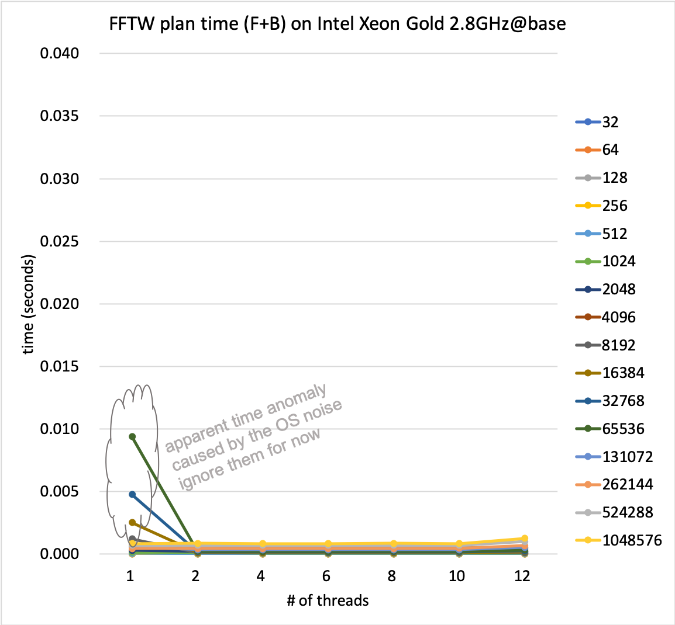
FFTW on Intel Xeon – 1D multi thread benchmark
double precision complex 1D threaded FFT
Note that FFTW here is only a wrapper to the native MKL FFT routines

Slide 41
FFTW on Fugaku – 3D multi thread benchmark
double precision complex 3D threaded FFT
Tested routine : dfftw_plan_dft_3d() and dfftw_execute_dft()
Out of place transformation – separate input and output data arrays
Tested plans: FFTW_ESTIMATE and FFTW_MEASURE
FFTW_ ESTIMATE | [plan(F+B)] |  |  |  |  | [execute(F+B)]
 | OMP_NUM_THREADS |  |  |  |  | OMP_NUM_THREADS
size | 1 | 2 | 4 | 8 | 12 | 1 | 2 | 4 | 8 | 12
8 | 0.000379 | 0.000674 | 0.000969 | 0.001261 | 0.002289 | 0.00001 | 0.00002 | 0.00002 | 0.00002 | 0.00005
16 | 0.000378 | 0.000661 | 0.000938 | 0.001480 | 0.002004 | 0.00006 | 0.00005 | 0.00004 | 0.00003 | 0.00005
32 | 0.000377 | 0.000665 | 0.000940 | 0.001472 | 0.002891 | 0.00109 | 0.00057 | 0.00030 | 0.00018 | 0.00084
64 | 0.000378 | 0.000674 | 0.000951 | 0.001490 | 0.003270 | 0.01158 | 0.00575 | 0.00294 | 0.00153 | 0.00531
128 | 0.000393 | 0.000681 | 0.000947 | 0.001499 | 0.004914 | 0.23375 | 0.12037 | 0.10488 | 0.05758 | 0.16319
256 | 0.003361 | 0.005131 | 0.006326 | 0.008551 | 0.012466 | 16.84835 | 14.47026 | 5.58232 | 3.17849 | 2.07715
512 | 0.003275 | 0.004974 | 0.006135 | 0.008178 | 0.013080 | 165.12981 | 85.69936 | 45.76431 | 25.62803 | 17.61705
1024 | 0.003467 | 0.005192 | 0.006347 | 0.008342 | 0.013409 | 1324.51123 | 668.31982 | 340.24783 | 174.44534 | 119.70940
FFTW_ MEASURE | [plan(F+B)] |  |  |  |  | [execute(F+B)]
 | OMP_NUM_THREADS |  |  |  |  | OMP_NUM_THREADS
size | 1 | 2 | 4 | 8 | 12 | 1 | 2 | 4 | 8 | 12
8 | 0.005 | 0.010 | 0.011 | 0.009 | 0.018 | 0.000009 | 0.000019 | 0.000021 | 0.000026 | 0.000063
16 | 0.009 | 0.017 | 0.017 | 0.016 | 0.023 | 0.000056 | 0.000044 | 0.000036 | 0.000030 | 0.000040
32 | 0.088 | 0.127 | 0.114 | 0.096 | 0.126 | 0.000841 | 0.000462 | 0.000273 | 0.000219 | 0.000141
64 | 0.469 | 0.613 | 0.500 | 0.439 | 0.545 | 0.010062 | 0.005058 | 0.002566 | 0.001392 | 0.001597
128 | 2.951 | 4.480 | 3.392 | 2.665 | 3.738 | 0.135109 | 0.068329 | 0.036601 | 0.034326 | 0.068568
256 | 12.911 | 21.929 | 16.382 | 13.330 | 19.510 | 1.278429 | 0.635103 | 0.326432 | 0.175252 | 0.185636
512 | 60.696 | 91.942 | 77.241 | 69.590 | 86.165 | 11.450865 | 6.948103 | 5.644430 | 3.537406 | 2.553208
1024 | 240.941 | 339.847 | 272.015 | 233.914 | 301.209 | 64.482971 | 33.060299 | 17.217341 | 9.059461 | 6.689466

Slide 42
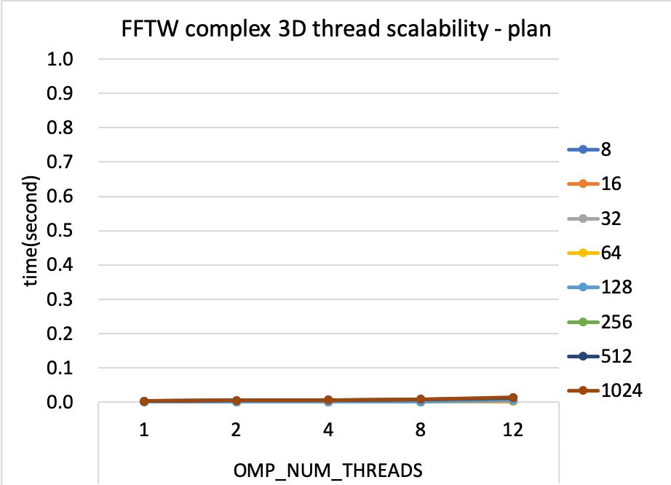
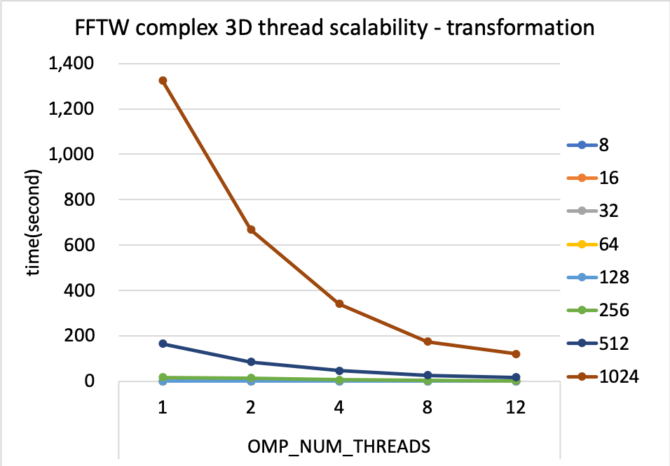
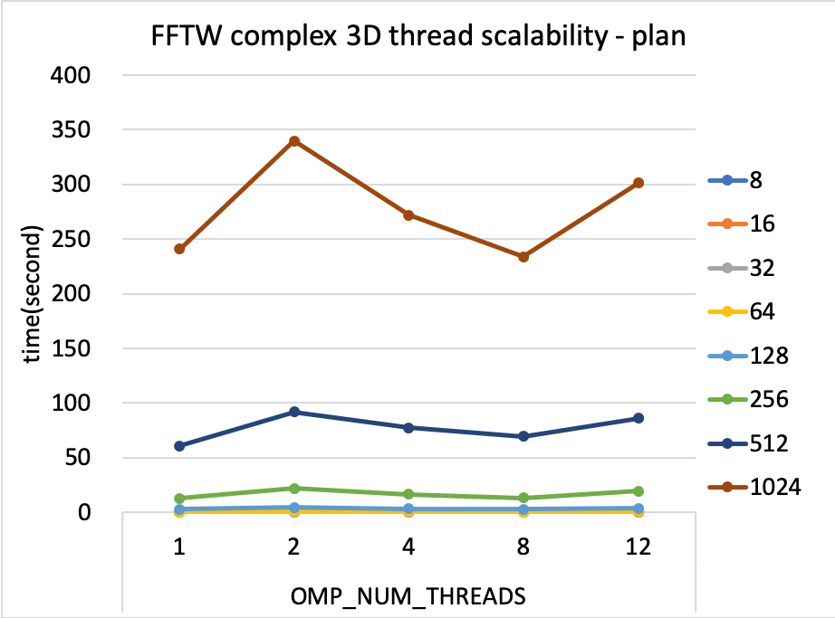
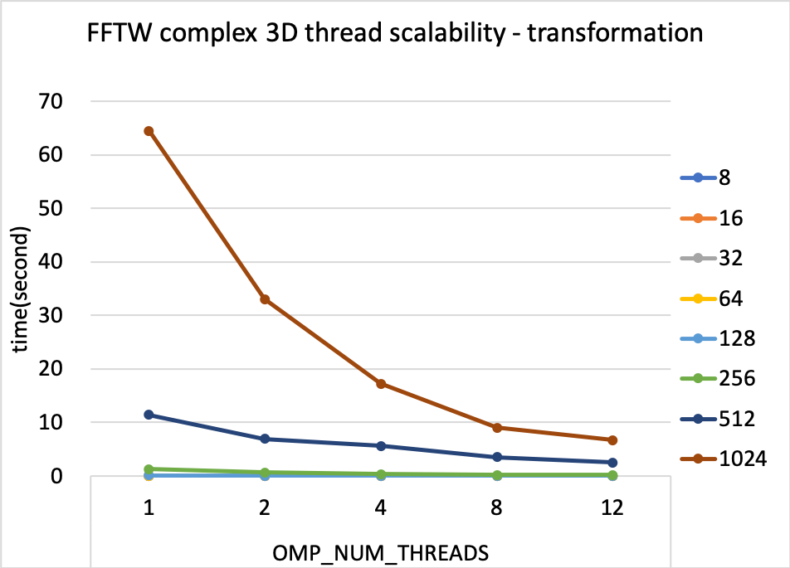
FFTW on Fugaku – 3D multi thread benchmark
FFTW_ESTIMATE
plan
FFTW_MEASURE
plan

Slide 43
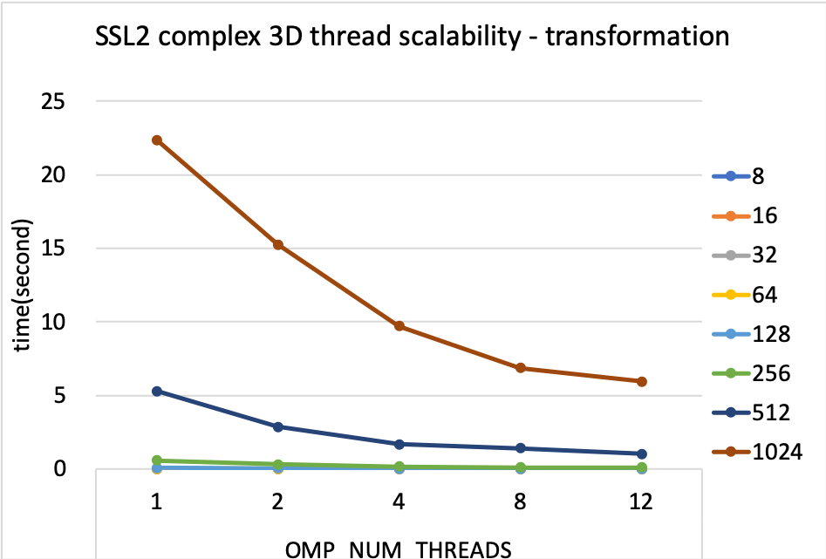
SSLII FFT on Fugaku – 3D multi thread benchmark
double precision complex 3D threaded FFT
Tested routine : dm_v3dcft2()
Inplace transformation, size is limited to 2, 3, 5, 7 radix factorizable size
 | [SSL 3D threaded (F+B)]
 | OMP_NUM_THREADS
size | 1 | 2 | 4 | 8 | 12
8 | 0.001869 | 0.000306 | 0.000408 | 0.000514 | 0.000641
16 | 0.001783 | 0.001678 | 0.002142 | 0.016672 | 0.010385
32 | 0.002445 | 0.001418 | 0.000928 | 0.000802 | 0.000737
64 | 0.010723 | 0.005934 | 0.003845 | 0.003278 | 0.002989
128 | 0.072431 | 0.040637 | 0.024806 | 0.015946 | 0.013639
256 | 0.569801 | 0.325081 | 0.183145 | 0.118146 | 0.096857
512 | 5.302363 | 2.854097 | 1.684468 | 1.412452 | 1.041058
1024 | 22.371090 | 15.247807 | 9.715441 | 6.865058 | 5.958510

Slide 44
FFTW on Fugaku – 3D distributed benchmark
double precision complex 3D threaded FFT
Tested routine : fftw_mpi_plan_dft_3d () and dfftw_execute_dft()
1,4,16, 48 processes on a single node
data size : 1024 x 1024 x 512
Tested plans: FFTW_ESTIMATE and FFTW_MEASURE
FFTW_ESTIMATE | NPROCS | 1 | 4 | 16 | 48
 | plan | 0.005 | 0.128 | 2.367 | 3.871
 | transformation | 1221.534 | 179.992 | 56.111 | 7.693
FFTW_MEASURE | NPROCS | 1 | 4 | 16 | 48
 | plan | 500.440 | 285.634 | 150.306 | 16.000
 | transformation | 70.347 | 16.277 | 4.175 | 2.814

Slide 45
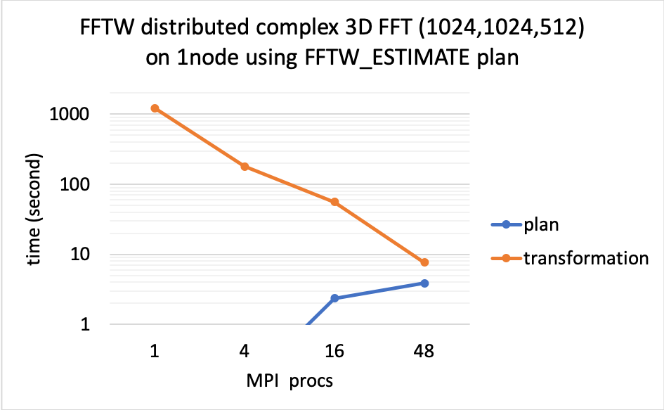
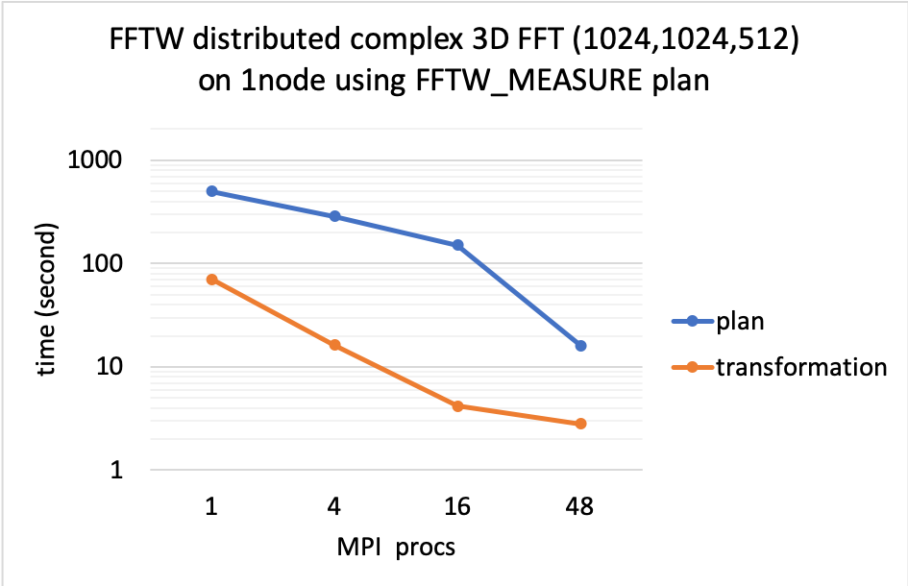
FFTW on Fugaku – 3D distributed benchmark
double precision complex 3D threaded FFT
Tested routine : fftw_mpi_plan_dft_3d () and dfftw_execute_dft()
1,4,16, 48 processes on a single node
Tested plans: FFTW_ESTIMATE and FFTW_MEASURE

Slide 46
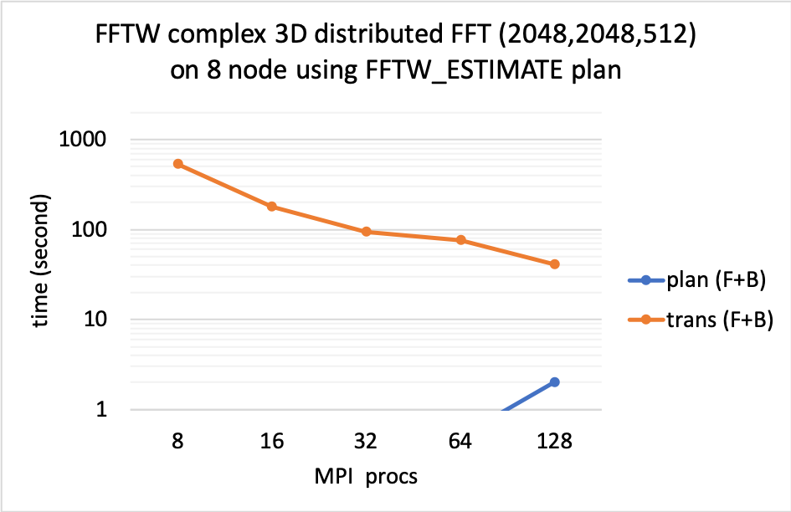
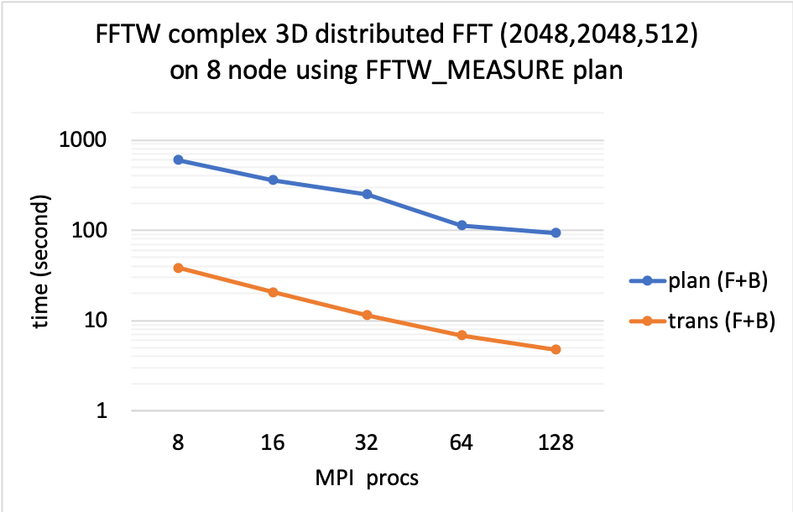
FFTW on Fugaku – 3D distributed benchmark
double precision complex 3D threaded FFT
Tested routine : fftw_mpi_plan_dft_3d () and dfftw_execute_dft()
Larger size FFT on 8 nodes
Tested plans: FFTW_ESTIMATE and FFTW_MEASURE

Slide 47
material
The benchmark codes, scripts, results shown in this talk can be obtained from the following repository
https://github.com/mikami3heart/FFT-benchmarks-2022
Thank you for your attendence

Slide 48
Typical FFT calls in the applications
Applications execute FFT in pairwise, i.e. forward transformation and backward synthesis, with the same FFT data size. Some applications do not follow this.
compute in time space
FFT : time space => freq. space
compute in freq. space
FFT : time space <= freq. space

Slide 49

SSL2-FFT vs FFTW on Fugaku – simple 1D benchmark
Closer look at the transformation (F+B) phase only
Performance bar in narrow scale
SSL2 and FFTW PATIENT/EXHAUSTIVE performance is close
Needs revise

Slide 50
FFT libraries on Fugaku performance experiments using FFTW and SSL2/FFT 2022/11/9 Kazunori Mikami

